Slide 1
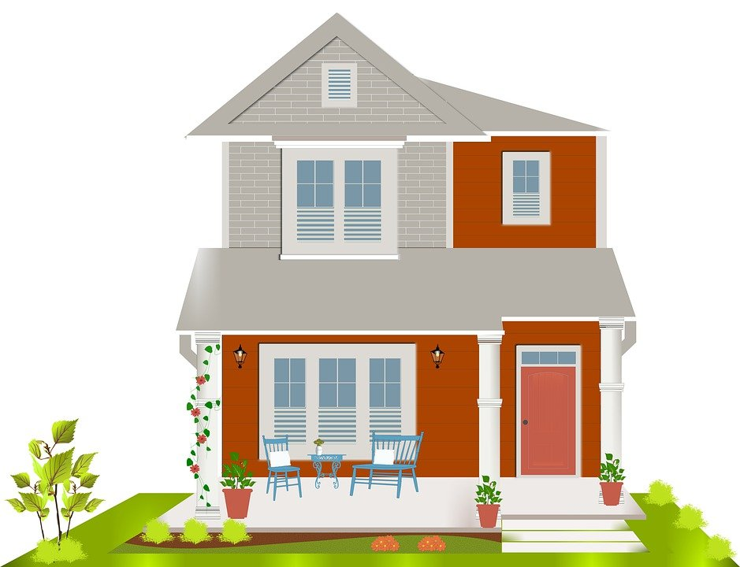
Housing Sales Price Analysis
By : Sheel Vohra

Slide 2
Objective
What features of a home influence the sale price?
This model can be used to help house flipping companies know what features to add to increase the price of a home.

Slide 3
Background
Dataset is acquired from Kaggle
Target variable is Sale Price of the homes
79 dependent variables with 1460 rows
Include features such as pools, garages, square footage of the first floor, etc.

Slide 4
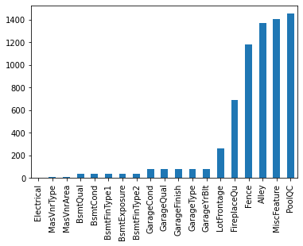
Handling Missing Values
This barchart shows missing values in the dataset
Missing data represents what the house is lacking
This will have an influence on price

Slide 5
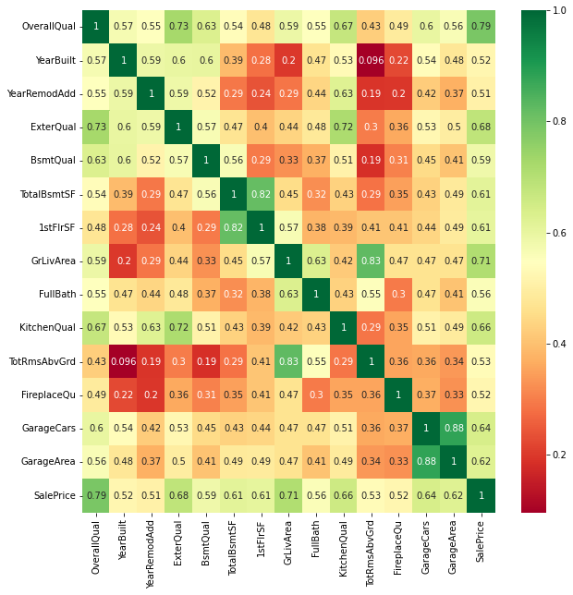
Correlation
Condensed heatmap for correlation
Features with a higher than 0.5 correlation with SalesPrice are included
Majority of the numeric data is not highly correlated with the price

Slide 6
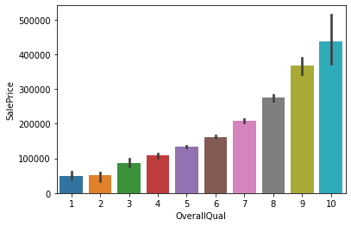
Visualizations
OverallQual is highly correlated with SalePrice
There is a trend with higher quality homes selling for a increasing price

Slide 7
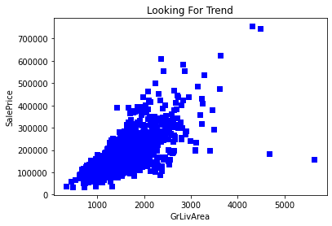
Visualizations
Scatter plot of comparing above ground living area (GrLivArea) and SalePrice
Some outliers were kept in the study
A general trend of increasing square feet means a more expensive home

Slide 8
Model Evaluation
Random Forest Model was Chosen
89% model accuracy
9% higher than Knn model
Model can be improved with more trees
Adding 100 more estimators improved the model by 1%
Random forests are also prone to overfitting

Slide 9
Recommendations
Certain features can be focused on to increase SalesPrice
Use quality of building materials
Increasing above square feet
Quality exterior and kitchens

